Slide 1
TrafAIQ
Smart traffic decision-making system powered by AI and Multi-agent collaboration.
Isaac Premkumar

Slide 2
Introduction
TrafAIQ leverages advanced AI techniques and multi-agent collaboration to analyze and optimize urban mobility, providing real-time solutions to traffic congestion and enhancing overall traffic management.

Slide 3
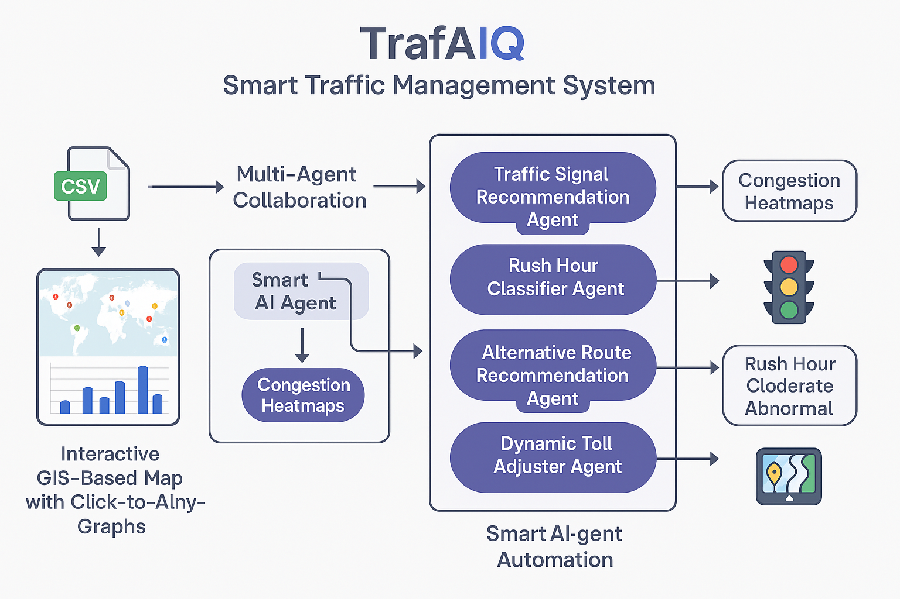
01
Multi-Agent Capabilities

Slide 4
Traffic Congestion Analyzer
The Traffic Congestion Analyzer uses both historical and real-time data patterns to identify bottlenecks in urban traffic flow. By visually representing congestion levels on interactive heatmaps, it enables city planners and traffic managers to quickly assess the severity of traffic conditions and deploy necessary interventions.

Slide 5
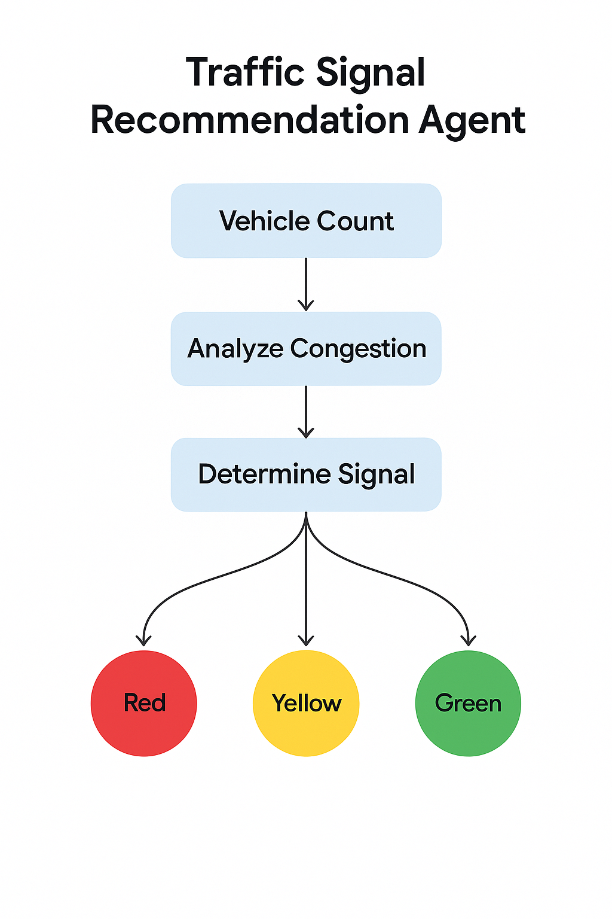
Traffic Signal Recommendation Agent
This agent intelligently determines the optimal signal colors (Red, Yellow, Green) for traffic lights at various intersections. It utilizes real-time data inputs such as vehicle density, accidents, and road obstacles to make informed decisions that improve traffic flow and reduce waiting times for drivers.

Slide 6
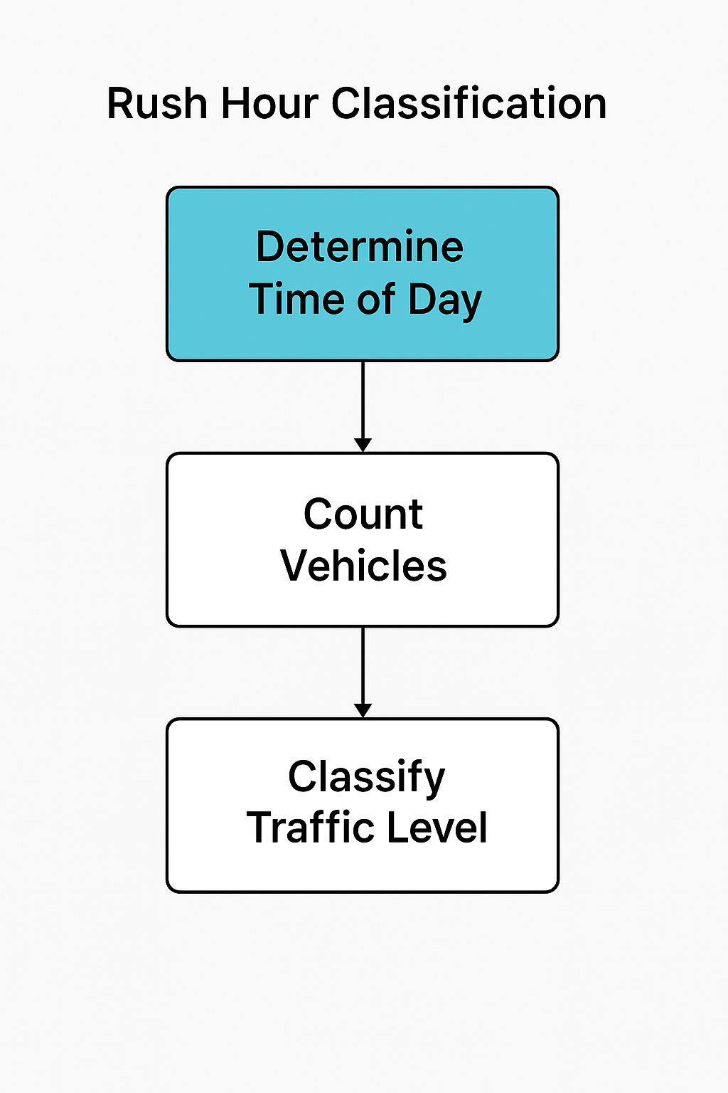
Rush Hour Classifier Agent
The Rush Hour Classifier Agent employs vehicle flow statistics to categorize time blocks into classifications such as Rush Hour, Moderate, Light, or Abnormal. By understanding these patterns, traffic management systems can better allocate resources and implement strategies that alleviate congestion during peak times.

Slide 7
02
Traffic Optimization

Slide 8
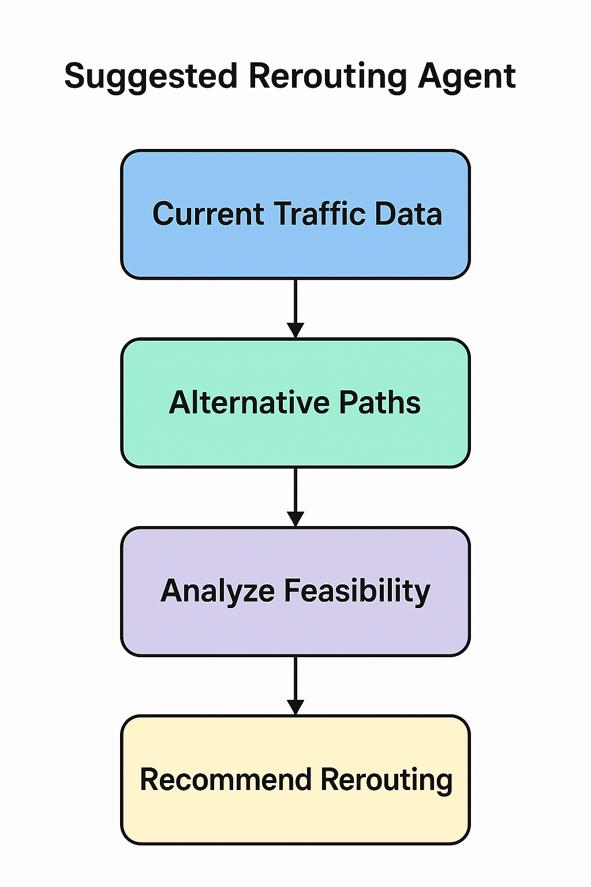
Alternative Route Recommendation Agent
This agent analyzes contextual data, including current congestion levels, roadblocks, and travel time savings to suggest alternate routes for drivers. By promoting smarter travel decisions, it helps minimize delays and enhance the overall traffic experience.

Slide 9
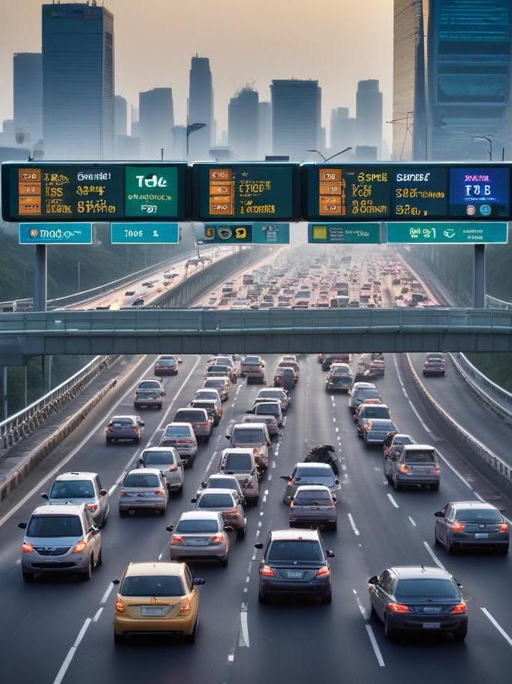
Dynamic Toll Adjuster Agent
The Dynamic Toll Adjuster Agent adjusts toll prices on certain routes in real-time based on various factors, including congestion levels and accident frequency. This system not only balances road usage and revenue generation but also encourages drivers to choose less congested paths.

Slide 10
Real-time Analysis and Insights
TrafAIQ provides real-time analysis and actionable insights to traffic management officials. Using geospatial visualization and interactive dashboards, stakeholders can monitor traffic conditions and make data-driven decisions to improve urban mobility and efficiency.

Slide 11

Conclusions
TrafAIQ's innovative multi-agent architecture revolutionizes traffic management by utilizing AI to analyze data in real-time and optimize urban mobility. By integrating various agents focused on traffic classification, congestion analysis, and routing suggestions, it significantly enhances the driving experience while reducing congestion.

Slide 12
Thank you!
Do you have any questions?
+91 620 421 838

